Slide 1


Bernard Savarimuthu
IBM Data SCIENCE PROFESSIONAL CERTIFIED
012 9288 956

Slide 2
Introduction
Fuel additives can help improve fuel efficiency
They paly an important role in in the deposit reduction in the combustion chamber and valves of the automobiles
FUEL ADDITIVES IS ALIQUID ADDED INTO THE FUEL SUPPLY OF VEHICLES THROUGH FUEL SYSTEM PARTS
SUPPLEMENTING YOUR FUEL WITH ADDITIVESGIVES BETTER PERFORMANCE OVER THE STANDARD FUEL

Slide 3
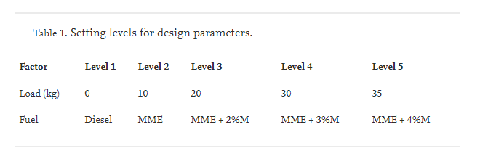
Summaries of findings (parametric)
Abstract :
The minimum number of experiments are required is given by the formula
where N = minimum number of experiments, L = number of levels, P = number of factors.

Slide 4
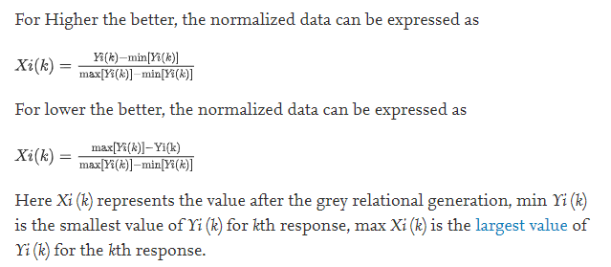
Summaries of findings (parametric) Continuation
So the minimum number of experiments to be performed is 9 so L9 orthogonal array is to be chosen. But, an orthogonal array design with 2 factors is the basic level of design. So the minimum number of experiments to be performed is the square of the number of levels.Hence the number of runs to be done is 52 = 25. So the L25 orthogonal array is chosen.

Slide 5

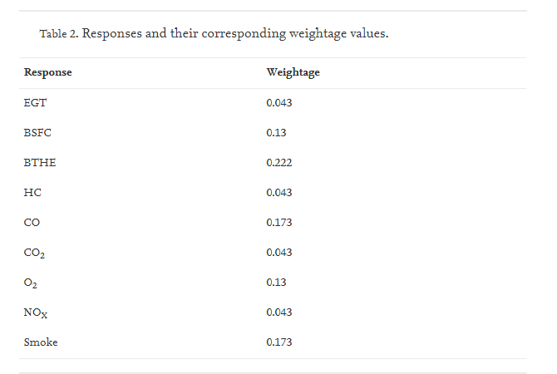

Table 2 represents the corresponding weightage factors for nine responses. These values are taken based on the suitability for later validation at RSM. Now, overall grey relational grade is determined by averaging the grey relational coefficient corresponding to selected responses. There are three types of S/N ratio normal the best, higher the better, lower the better by taking the higher the better the signal to noise ratio.

Slide 6
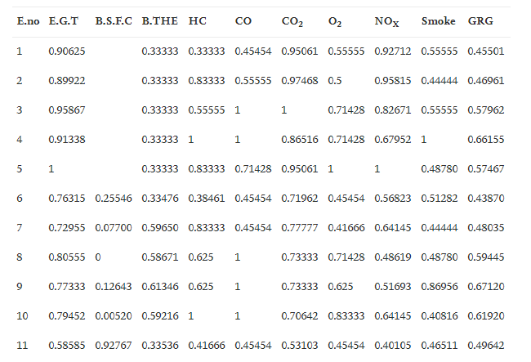
Summaries of findings (non-parametric)
Calculated grey relational coefficient and overall grey relational grade.

Slide 7
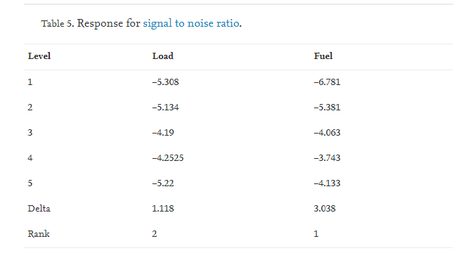
Summaries of findings (non-parametric)

Slide 8

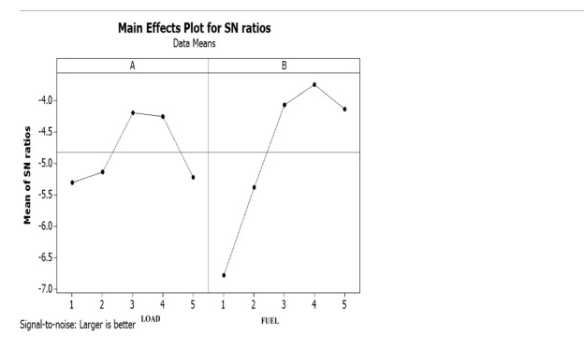
The main effects for S/N ratios is plotted and presented in Fig. 2. The optimum load level is 3 and the corresponding value is 20 kg and the optimum fuel level is 4 and the corresponding fuel is Mahua Methyl Ester + 3% Methanol

Slide 9

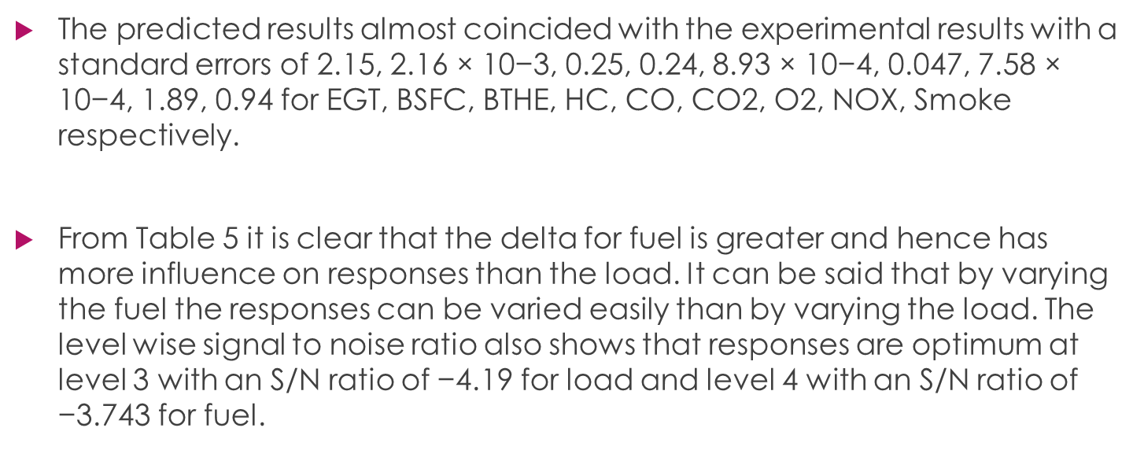
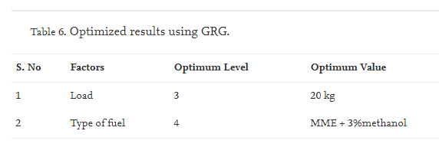

Slide 10

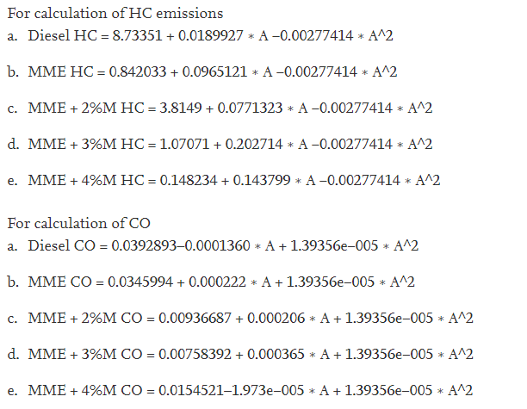
The predicted formula :

Slide 11

